Slide 1


QR_CARE
Digitalization of INDIA
The Thinkers
Tanisha Mudgal
Rajesh Pareek
Tanishq Goyal
Alpesh Gupta
Ronak Gupta
HackOFiesta-Flagship Hackathon of India
01

Slide 2

PROBLEM STATEMENT
Lack of transparency
42.5 Million small businesses are there in India (registered or non -registered) "To stay ahead of their competitors they need promotion"
Problems they are facing
Don't know the right method to promote.
Facing difficulties and complexities in hiring people to propagate their ideas.
Financially (hard copies) cost more in making their business cards and promotes business at small range.
Getting proper customer feedback, etc.
Problems to user
Out-and-out data to manage.
Poor approach to handle.
Chances of losing data.
Facing indecision for choosing right business.
Time management.

Slide 3

PROPOSED SOLUTION
The app aims to contribute in Digitalization of India. It uses the QR code technology to share the details/cards digitally.
"For every minute spent in organizing, an hour is earned"
With QR Care, User can
Make grouped contacts within a mono-code and fast searching of contacts.
Give feedback.
Ensure his earnings by referring cards of business men.
Make connections with them via various platforms (social & non-social).
Help those who are in need.
And will have satisfying service.
For businessmen
App will be more reasonable compared to hard copies (including updating).
Increased promotion of business.
Getting proper user reviews.

Slide 4

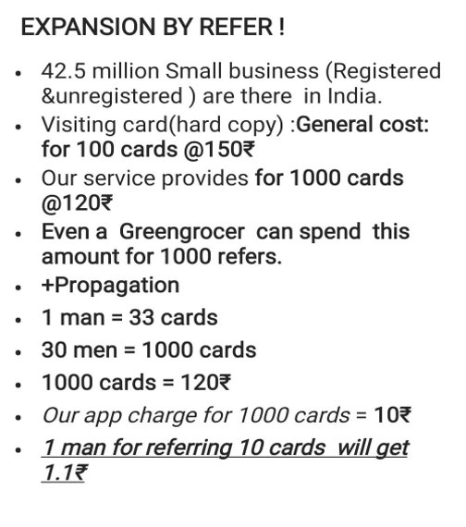
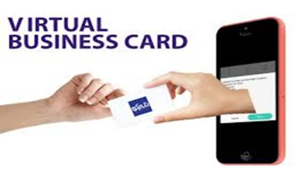

UNIQUE SELLING POINT
Expansion
By
Refer

Slide 5



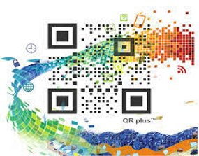
YOUR TECH STACK
FRONT-end
1.
XML with Material Design
2.
BACK-end
JAVA, Google Firebase

Slide 6
CONCLUSION
QR Care ensures for businessmen to increase their reach, expand business and reduction of people’s management complexity.
Thus, this modern day digital card application is the perfect app to improve the Business Industry.

Slide 7
THANK YOU

